Slide 1
Convolutional neural networks for computer vision

Slide 2
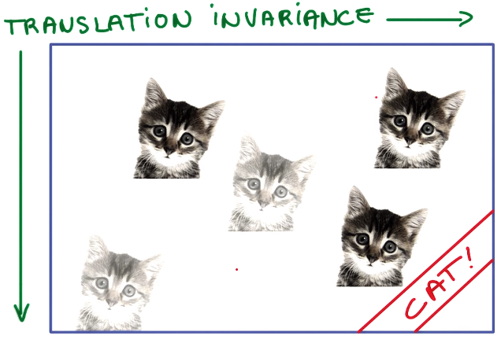
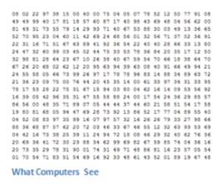
A big challenge for computer vision: Translational Invariance
Let’s say you want to detect cats in an image
You probably will want to recognize cats anywhere in the image
This capability is called translational invariance
The machine learning models we have seen so far do not scale well to this type of problem
You would need to train such models with data containing images of cats in different locations

Slide 3
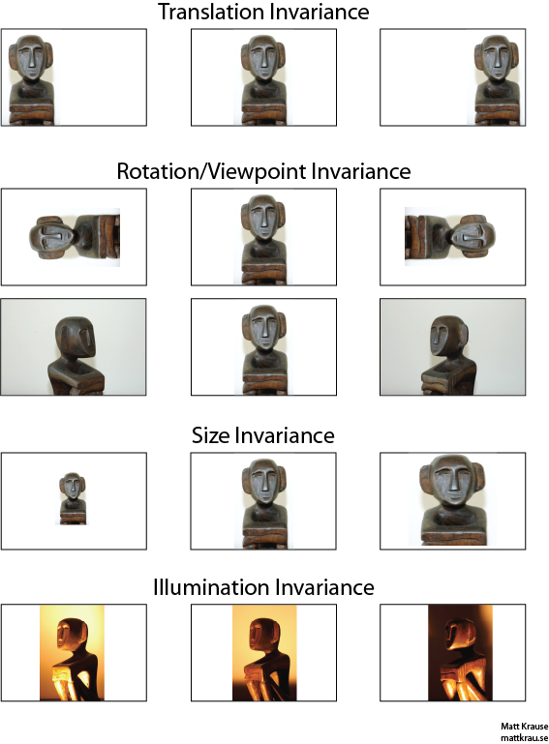
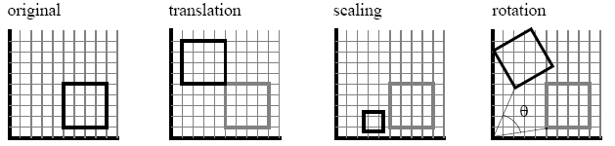
Other types of Invariance
The human brain is very good at handling several types of invariance
Hence, perception invariance seems trivial to us since we are very good at it
But achieving perception invariance is very hard for machine vision systems

Slide 4
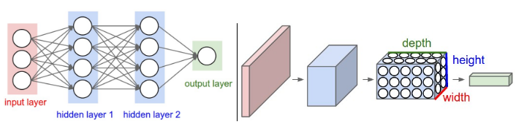
Convolutional neural networks
Fully connected Regular Artificial Neural Nets don’t scale well to computer vision tasks due to the invariance problem
This is where convolutional neural networks come into the picture
Convolutional Neural Networks take advantage of the fact that the input consists of images and they constrain the architecture of the network in a sensible way to deal with invariance.
In particular, unlike a regular Neural Network, the layers of a ConvNet have neurons arranged in 3 dimensions: width, height, depth.
Note that the word depth here refers to the third dimension of an activation volume, not to the depth of a full Neural Network, which can refer to the total number of layers in a network
Dense (fully connected) neural network
Convolutional neural network

Slide 5



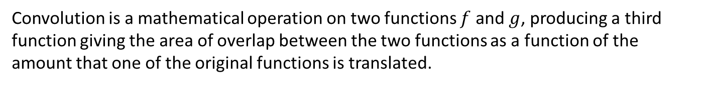
Convolution is a mathematical operation on two functions $f$ and $g$, producing a third function giving the area of overlap between the two functions as a function of the amount that one of the original functions is translated.

Slide 6
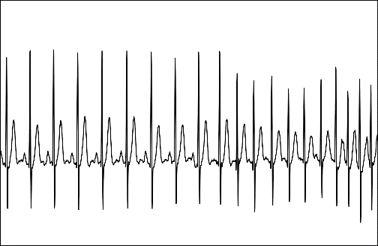

What would 1D convolutions be useful for?
Detecting events in a signal
For example: heartbeats in electrocardiogram
ECG
$$∗$$
1 | 20 | 15 | 3 | 18 | 12 | 4 | 17
1 | 3 | 10 | 3 | 1

Slide 7
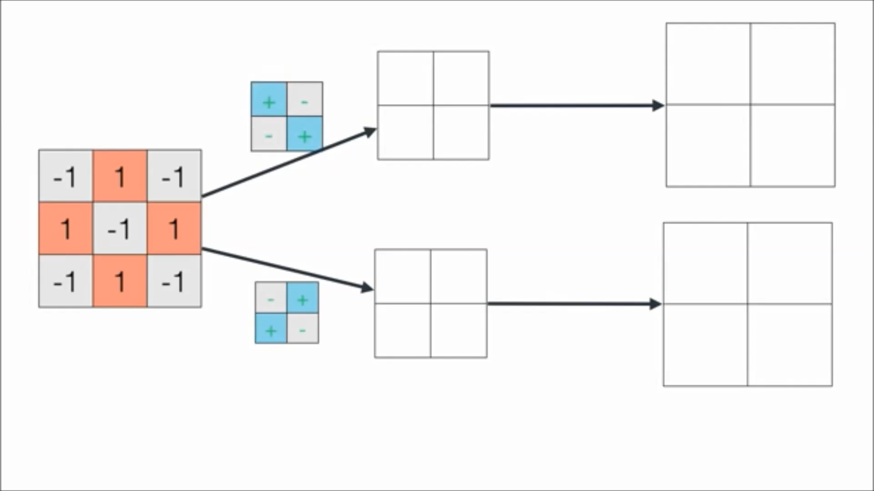
2D Convolution: degree of similarity (i.e. dot product) between a filter/kernel and each patch of the image to generate as output a feature map
Original
Image
Computer representation of the image
Kernels/Filters
Feature maps
Presence of features in original image

Slide 8

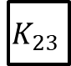
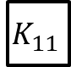
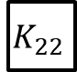
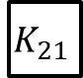
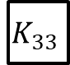
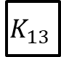
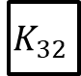
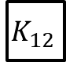
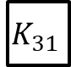
Convolutional networks
Convolutional neural networks share their parameters (weights/kernels/patches) across space
Output feature map
$$K_{11}$$
$$K_{12}$$
$$K_{13}$$
$$K_{21}$$
$$K_{22}$$
$$K_{23}$$
Kernel
$$K_{31}$$
$$K_{32}$$
$$K_{33}$$
Input feature map or original image

Slide 9






1
0
1
This Kernel is designed to detect this pattern anywhere in an image
0
$$1$$
$$0$$
$$1$$
$$0$$
$$1$$
Output feature map after applying convolution with above kernel
5x5 Image
Numerical representationof image

Slide 10
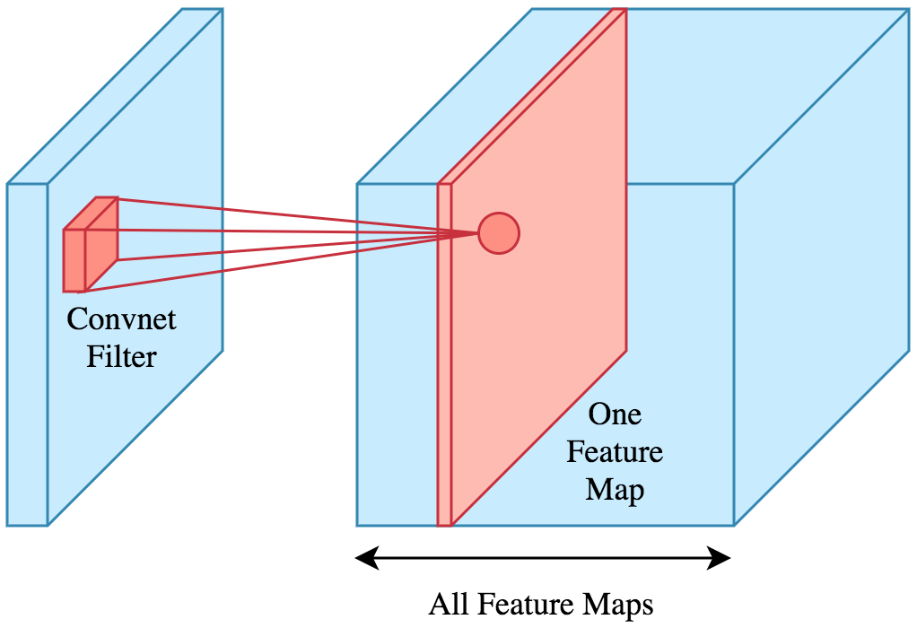
Each convolution layer generates as output several feature maps: One for each kernel
Image
(i.e. output of a convolutional neural layer)

Slide 11
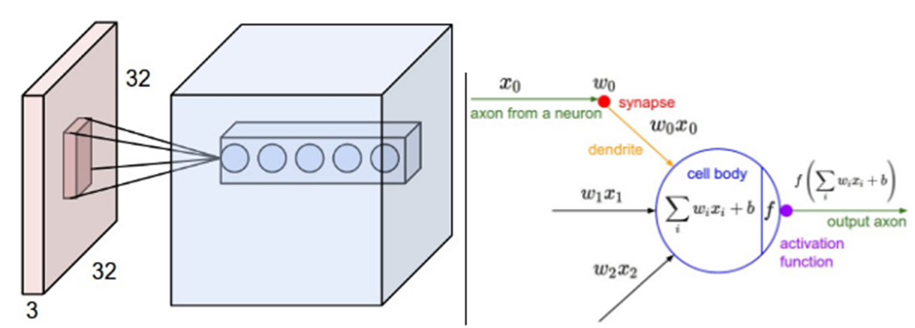
Convolutional neural networks
A ConvNet arranges its neurons in three dimensions (width, height, depth).
Every layer of a ConvNet transforms the 3D input volume (remember color images have 3 color channels RGB) to a 3D output volume of feature maps.
In the example below, the red input layer holds the image, so its width and height would be the dimensions of the image, and the depth would be 3 (Red, Green, and Blue channels).

Slide 12
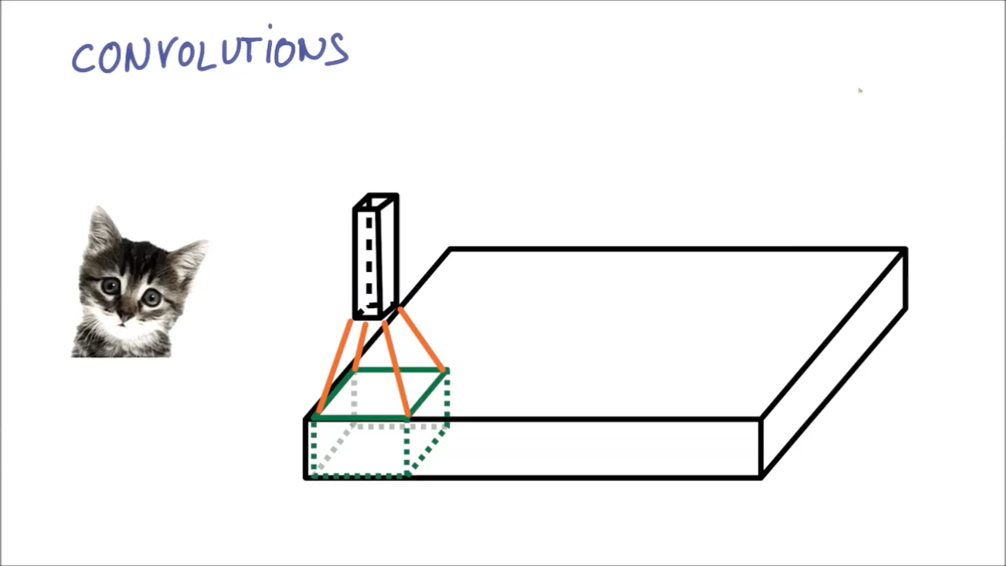
Convolution
Slide the kernel across the image
Notice that we are using a small patch/kernel and sharing the weights across space

Slide 13
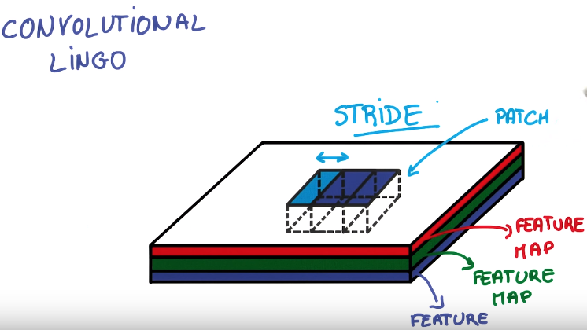
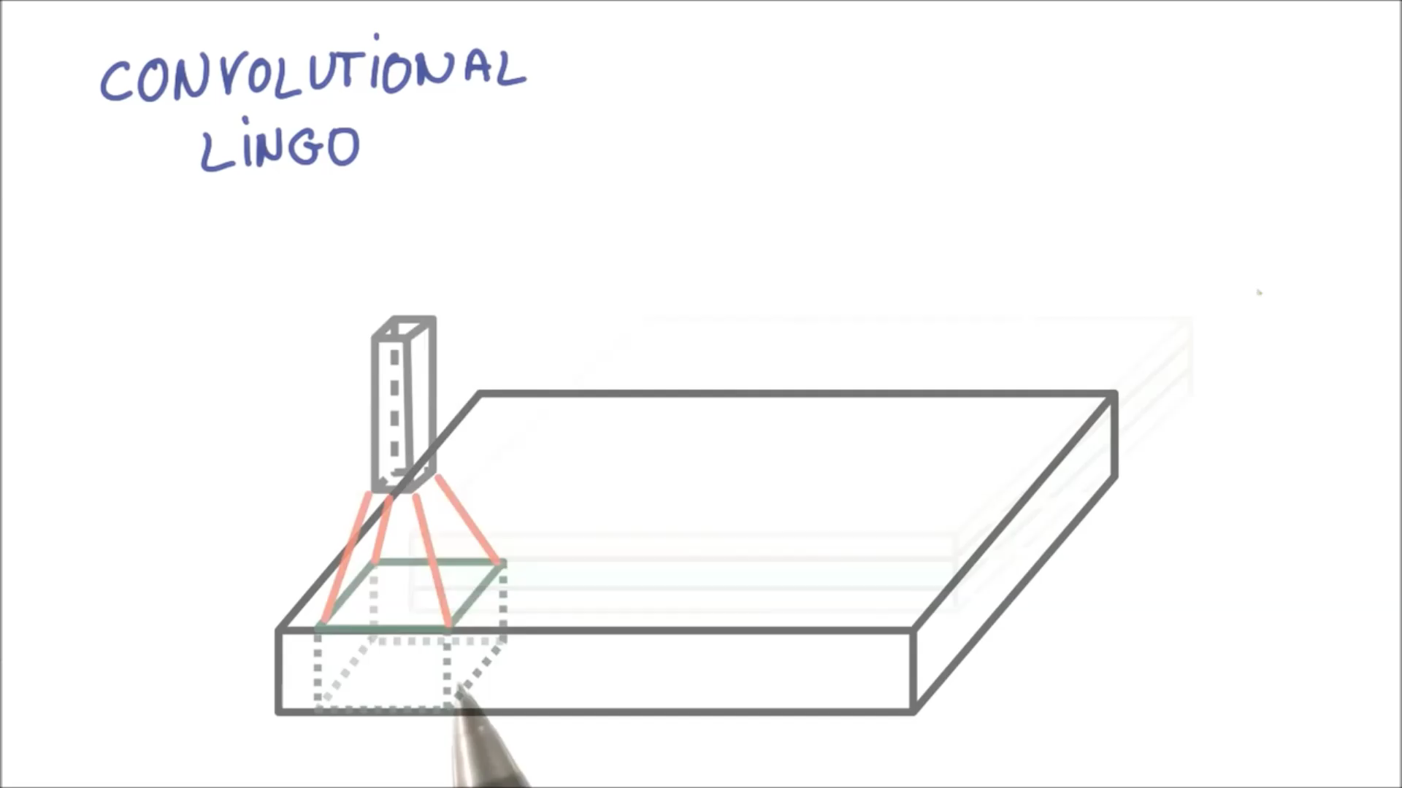
Stride refers to the number of pixels that you are shifting each time you move your filter/kernel/patch
A stride of 1 makes the output roughly the same size as the input
A stride of 2 makes the output half the size of the input

Slide 14
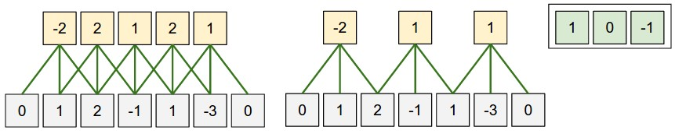
Illustration of stride size
The neuron weights are in this example [1,0,-1] (shown on very right), and its bias is zero. These weights are shared across all yellow neurons
Left: The neuron strided across the input in a stride of S = 1, giving output of size 5.
Right: The neuron uses stride of S = 2, giving output of size 3.
Kernel

Slide 15
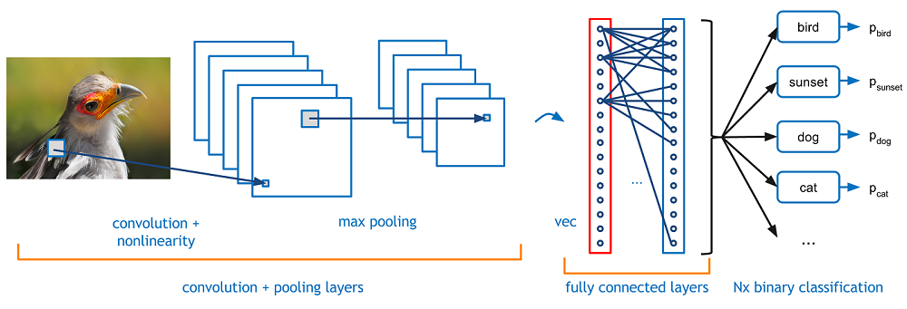
Layers used to build ConvNets
A simple ConvNet is a sequence of layers
Every layer of a ConvNet transforms one volume of activations to another
Convolutional neural networks use three main types of layers to build ConvNet architectures:
Convolutional Layer
Pooling Layer
Fully-Connected Layer (exactly as seen in regular Neural Networks).
We will stack these layers to form a full convNet architecture.

Slide 16
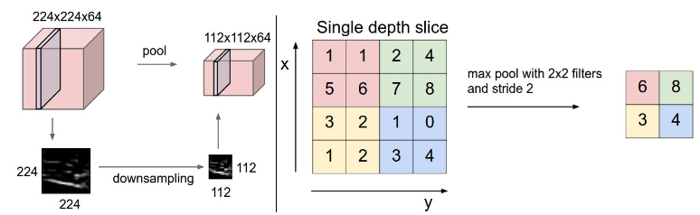
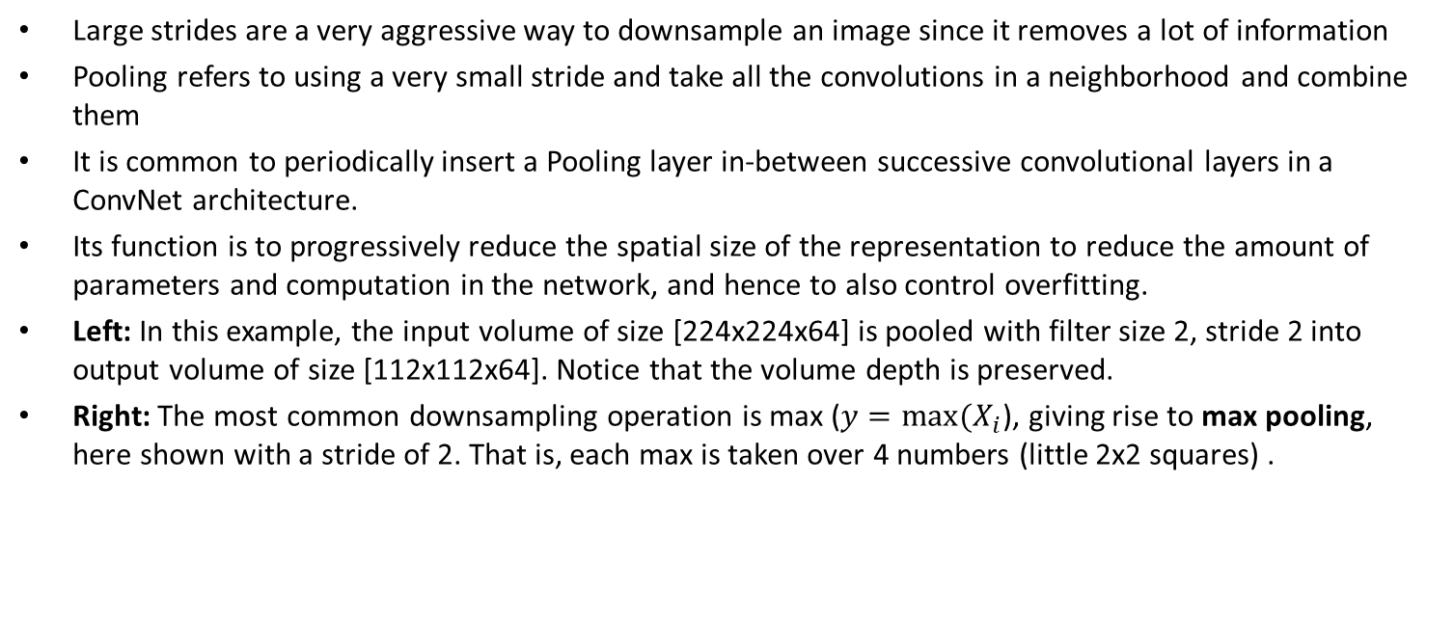
Pooling Layer
Large strides are a very aggressive way to downsample an image since it removes a lot of information
Pooling refers to using a very small stride and take all the convolutions in a neighborhood and combine them
It is common to periodically insert a Pooling layer in-between successive convolutional layers in a ConvNet architecture.
Its function is to progressively reduce the spatial size of the representation to reduce the amount of parameters and computation in the network, and hence to also control overfitting.
Left: In this example, the input volume of size [224x224x64] is pooled with filter size 2, stride 2 into output volume of size [112x112x64]. Notice that the volume depth is preserved.
Right: The most common downsampling operation is max ($y=max⁡(X_{i}$), giving rise to max pooling, here shown with a stride of 2. That is, each max is taken over 4 numbers (little 2x2 squares) .
Output feature map of a convolutional step
Output of max pooling step

Slide 17
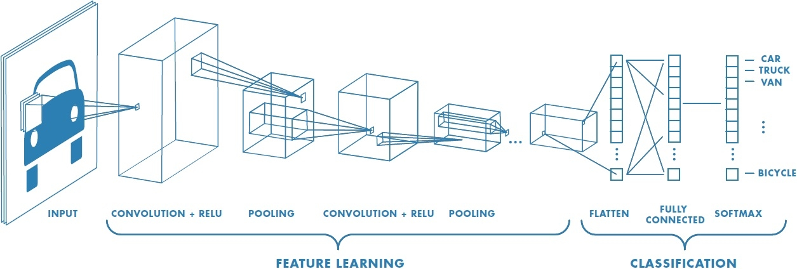
Convolutional pyramid (or deep network)
You apply convolutions and pooling that are going to progressively squeeze the spatial dimensions while increasing the depth which corresponds roughly to the semantic complexity of the representation
At the top you have a representation where all the spatial information has been squeezed out and only parameters that map to content of the image remain
RGB image

Slide 18

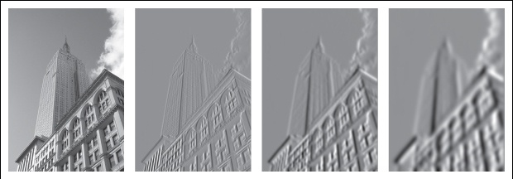
Instead of using hand engineered features the network learns on its own what features to look for
The network learns on its own the specific kernels (feature detectors) to use in each layer of the network
In the first layer of the network, these are some of the kernels that are learn: basically edge detectors

Slide 19
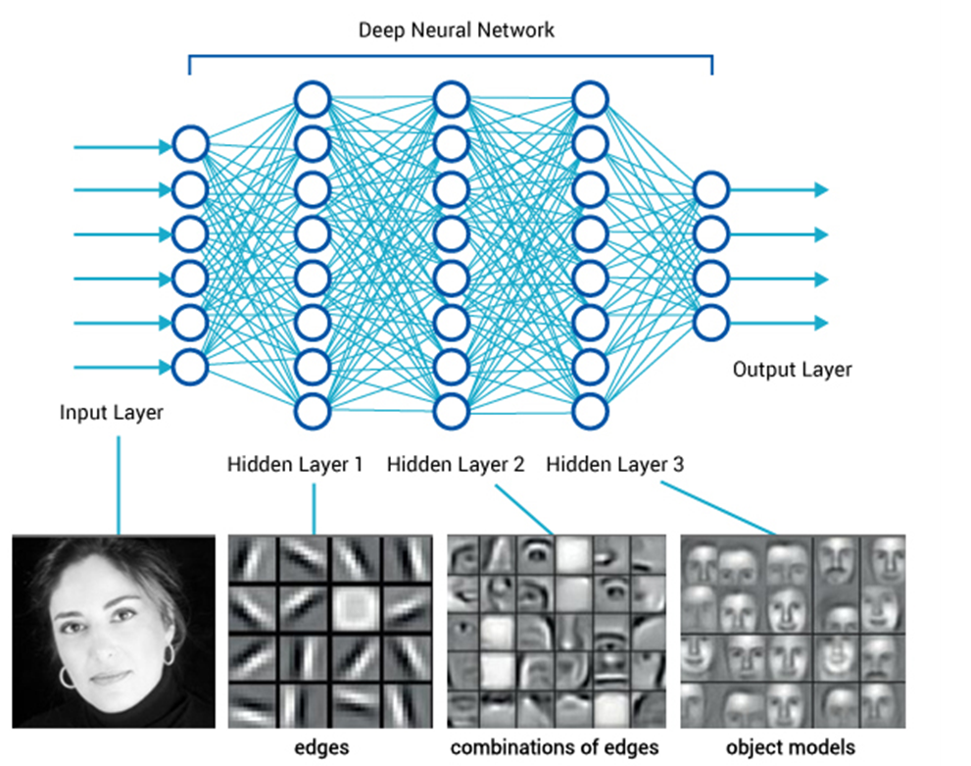
Why parameter sharing and hierarchical representations makes sense
If detecting a horizontal edge is important at some location in the image, it should intuitively be useful at some other location as well due to the translationally-invariant structure of images.
There is therefore no need to relearn to detect a horizontal edge at every one of the distinct locations in the Conv layer output volume.
There is a case to be made in terms of parameter efficiency→strong neurobiological analogy

Slide 20
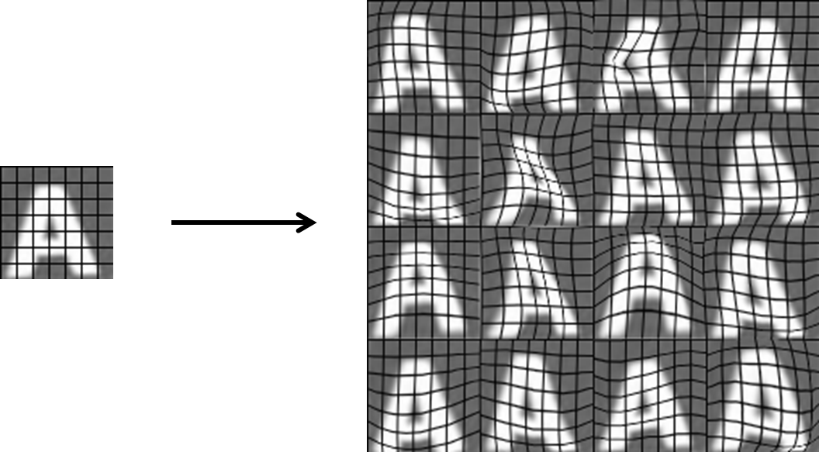
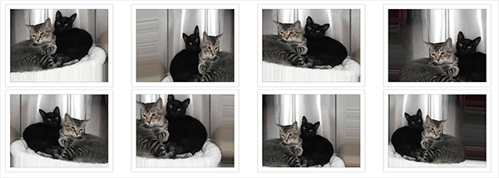
Data augmentation
In order to make the most of few training examples, we can "augment" them via a number of random transformations, so that our model is exposed to more data.
This helps prevent overfitting and helps the model generalize better.
Rotations
Width/Height shifts
Shear
Zooming
flips

Slide 21

Take-home message: typical architecture of convolutional neural network

